Slide 1
I-Tub (Intelligent-Tub)
bathtub service platform that combines bigdata and iot-technology
Semester : 2020-1
Subject : CapstonDesign1
Professor : Jung Hyunsook
TeamName : Ultimate
Leader : Lim Daein (20154300)
Members : Jeong Haemin (20144748)
: Seo Jeonguk (20154199)
: Park Jisu (20154280)

Slide 2
Contents
1. Team Introduction
2. Topic Selection
3. I-Tub Project Introduction
4. I-Tub Data of using
5. I-Tub Service Implement and Prototype Modeling
6. I-Tub Supplement Point
7. References
3-1) I-Tub Development Environment
3-2) I-Tub System Architecture
4-1) I-Tub Data collecting
4-2) I-Tub Data preprocessing
and visualization
4-3) I-Tub Data Learning
and Selection
5-1) I-Tub Website diagram
5-2) I-Tub Prototype Modeling

Slide 3
Team Introduction

Slide 4

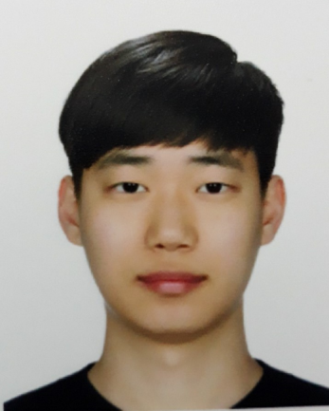
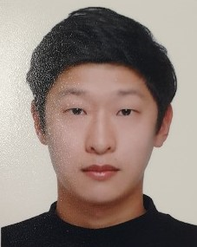

I-Tub Team Introduction
Lim Daein (Leader)
Seo Jeonguk (Member)
Computer Engineering
2015
dnfwlxo11@naver.com
Web back-end
IoT coding
Data analysis
Prototype modeling
Computer Engineering
2015
junguk7880@naver.com
Web front-end
Park Jisu (Member)
Jeong Haemin (Member)
Computer Engineering
2015
xrl0603@naver.com
Database design
Prototype modeling
Computer Engineering
2014
jhm0828@gmail.com
Web front-end
Data collecting

Slide 5
Topic Selection

Slide 6
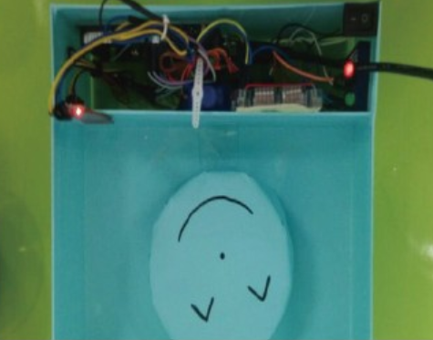
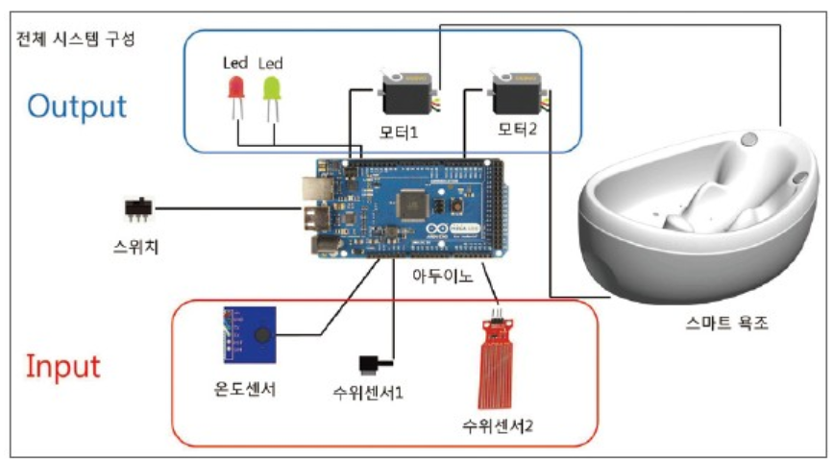
I-Tub Relevant Research or Project
http://www.ntrexgo.com/archives/31916 <Smart bathtub>
Pusan National University In 2016
ICT Convergence Project Contest
Topic : Bathtub that added smart function
Function List :
1. Waterlevel control
2. Setting and maintaining the temperature of water
3. Automatical drainage
Summary : A one click of a button proceeds with three functions sequentially

Slide 7
I-Tub Relevant Research or Project (Differentiation point)
Bathtub with simple temperature of water and water level control and drainage function
Smart bathtubs with bigdata and machine running,
Including temperature of water and water control with .
customizing

Slide 8
I-Tub Topic selection
Simply bathing Getting Rest and Enjoyment
Development motivation
To make the bath ate the start and end of the day more valuable
Development purpose
Automated system for more convenient use
To allow users to take a bath in their favorite environment
To maximize user convenience by combining with big data
Expectancy effects
Satisfy the needs of younger generations who want customized services and convenient use
Expected that will be contents such as Jimjilbang instead of ending in simply bathing

Slide 9
I-Tub Project Introduction
I-Tub Development Environment
I-Tub System Architecture

Slide 10
I-Tub Development Environment
1
2
3
VSCode
Node.js
MySQL
To use multiple codes,
Such as JS, PY, etc…
in one editor
Asynchronous Webserver operation for out intend
To store user data
and sensor data
Source Code Editor
Webserver Platform
Using and storing data
4
5
Heroku
Python
Use for simple distribution of web servers free of charge
Used for raspberry pie sensor and machine learning coding
Support Platform about
Webserver Distribution
RaspberryPi Control

Slide 11
I-Tub Development Environment
Install | Program | Version | Description
1 | VSCode | 1.44.2 | When writing HTML files, there are real-time previews, many convenience features, and Java scripts are supported.
https://code.visualstudio.com/
2 | Node.js | 12.16.2 LST | A web server platform for creating and serving web pages and can open and close servers with a few lines of code.
https://nodejs.org/ko/
3 | MySQL | 8.0 | To use the CRUD(Create, read, update, delete) function for the user's information or the user's information.
https://www.mysql.com/
4 | HEROKU | 7.39.5 | As a platform that supports web distribution, it is easy to distribute the web and supporting uses Node.js.
https://www.heroku.com/
5 | Python | 3.6 | Required for temperature and water control via various sensors in raspberry pie, also it use interprinter language
https://www.python.org/

Slide 12
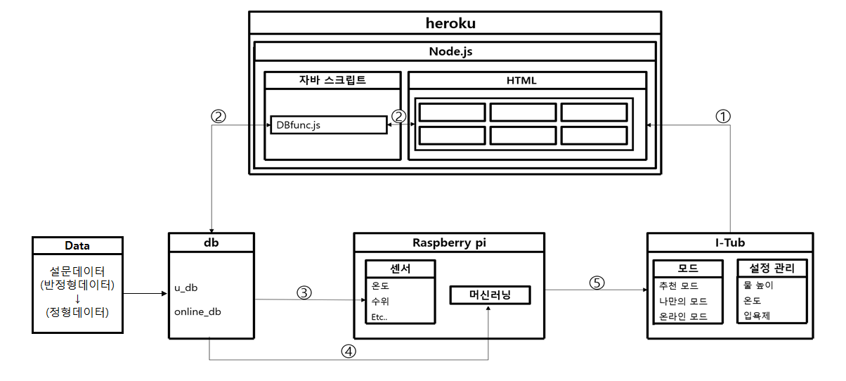
I-Tub System Architecture
JavaScript
Register
Proflie select
Mode select
Own setting
Recommend
Online mode
Survey Data
Unstructured data
->
Structured data
sensor
Mode
Setting
Temperature
Water level
Etc…
Recommend
Own
Online
waterlevel
temperature
bathbomb
Machine learning

Slide 13
I-Tub Data of using
I-Tub Data Collecting way
I-Tub Data preprocessing and analysis
I-Tub Data Learning Model
Comparing and Selecting

Slide 14
I-Tub Data Collecting way
● Select items that are considered important and collect data through surveys using Google Form because there is no variable data for I-Tub (total : 3290)
Question <Total 7 items> | Answer
What is your gender? | Male/female
What is your age? | Write age
What is your preferred temperature? | Write temperature
What`s the Average bath start time? | Write average bath start time
How long does it take to take a bath? | Write bath time
Do you use bath bombs? | Check yes or not
What is your job? | Write job

Slide 15
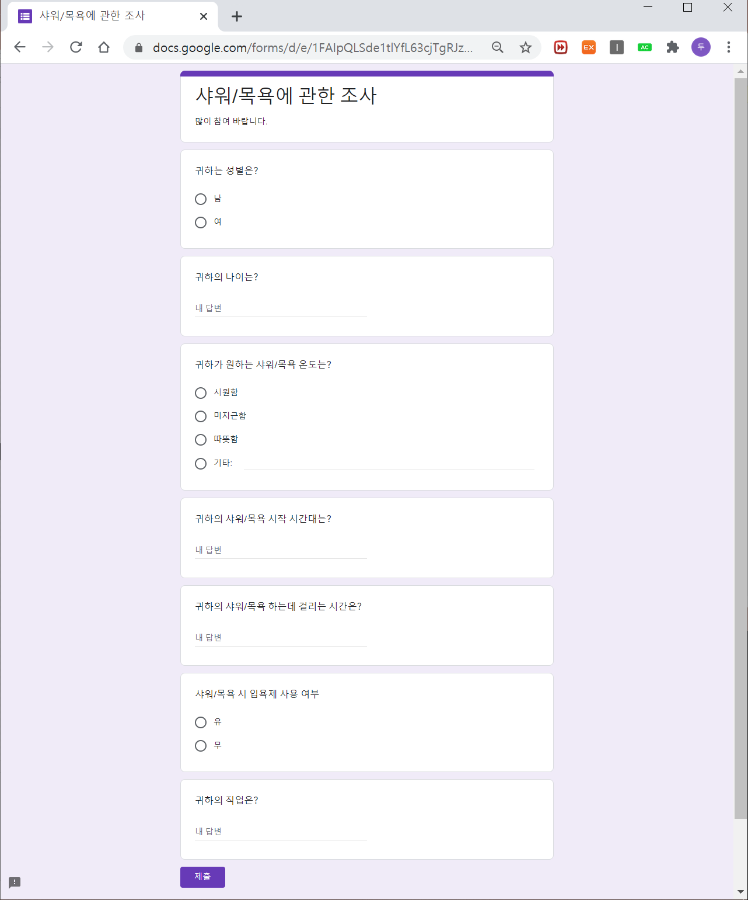
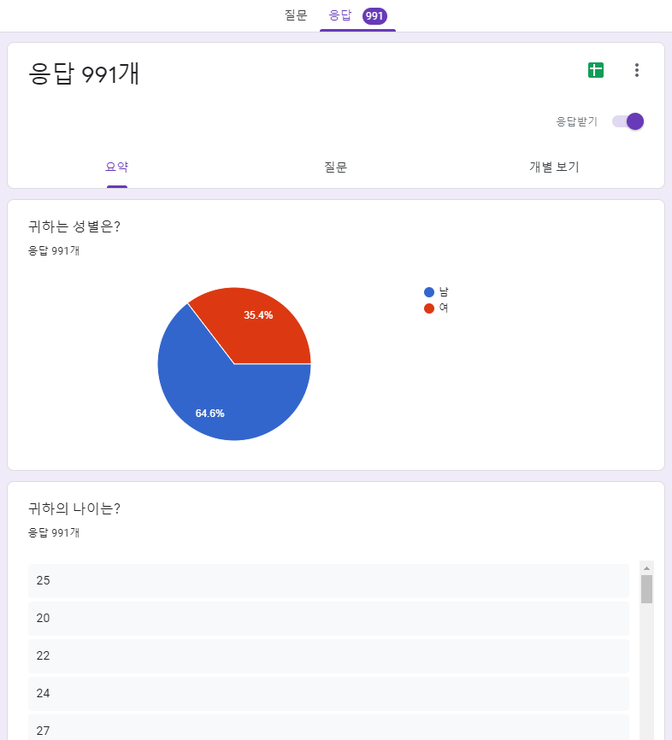
I-Tub Result of Data Collecting
● Survey and survey result
In GoogleForm
● It`s total recode: 991 EA
We add randomly data
For accurate analyses
So our total recode is 3290EA

Slide 16
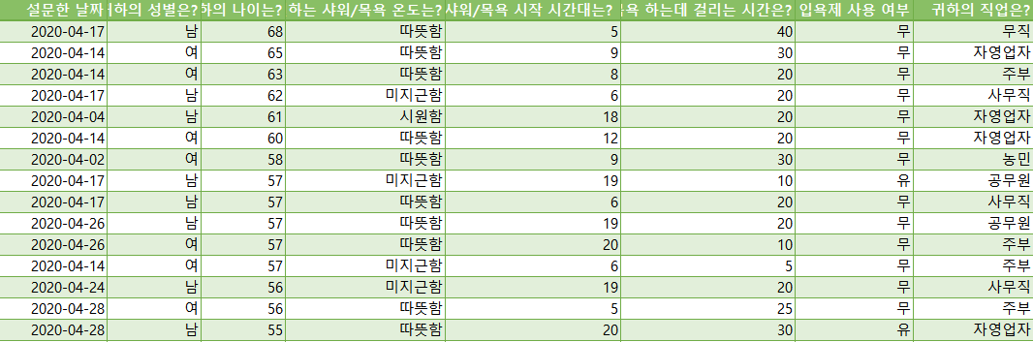
I-Tub Result of Data Collecting
● Requires data preprocessing about unanswered in the intended format
1
2
3
4
Gender | Age | Temperature | Bath start time | Bathing time | bathbombs | job

Slide 17
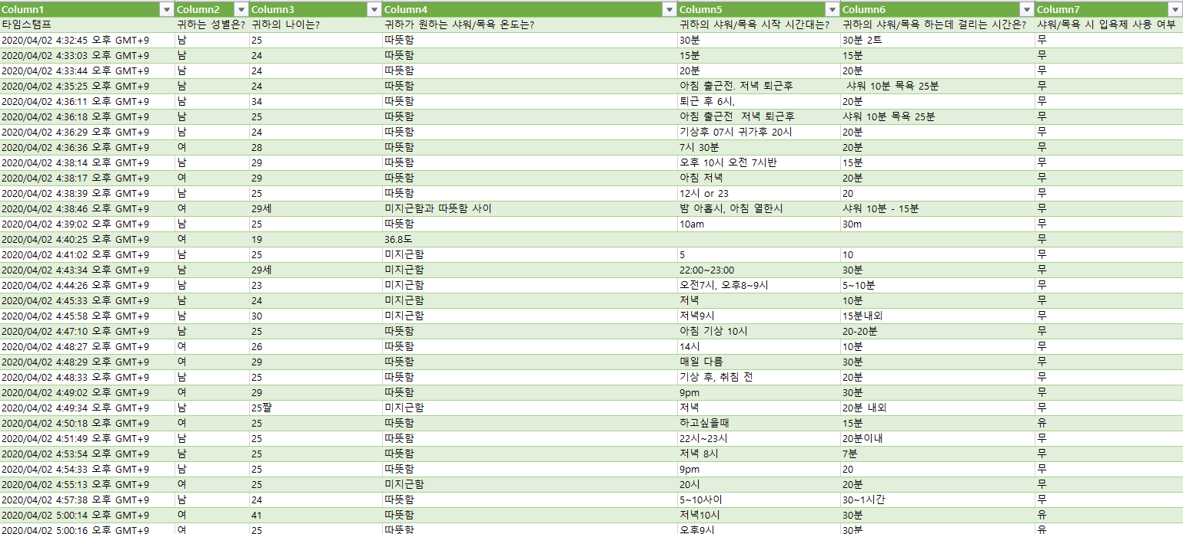
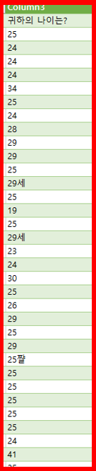
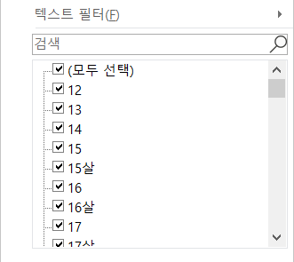
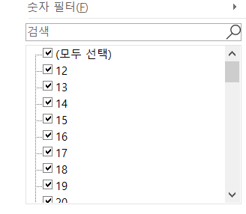
I-Tub Data Preprocessing
Age
Temperature
Bath start time
4
Bathing time
1
2
3
Table1 : age
Average | MIN | MAX
28 | 12 | 68
1
Age
● Remove all characters to save to an integer field
Column2

Slide 18
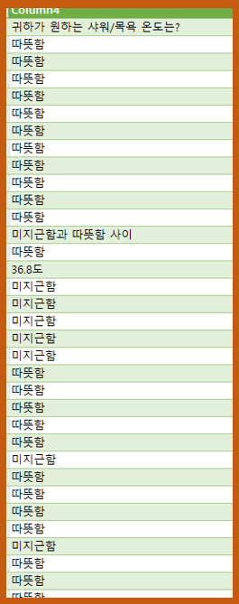
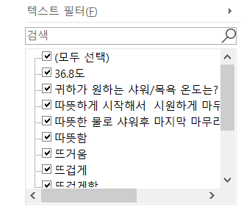
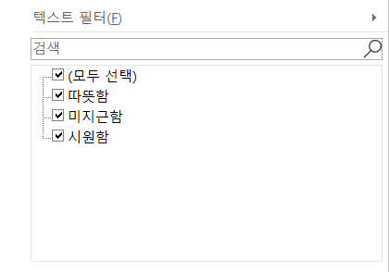
I-Tub Data Preprocessing
Age
Temperature
Bath start time
4
Bathing time
1
2
3
Table2 : Temperature
according to number of columns
Hot > Cold > Normal
2
Temperature
● Too many answers come out and merge into similar items in the same

Slide 19
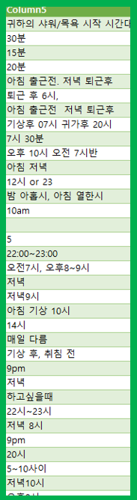
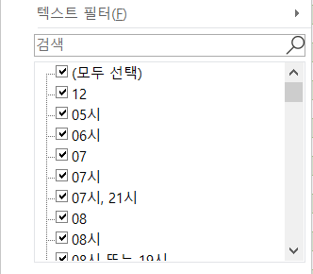
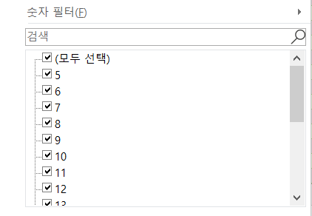
I-Tub Data Preprocessing
Age
Temperature
Bath start time
4
Bathing time
1
2
3
Table3 : bath strat time
Average | MIN | MAX
16 | 5 | 23
3
Bath start time
● Convert all to 24-hour integers for storage in integer fields

Slide 20
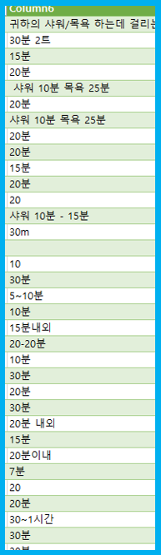
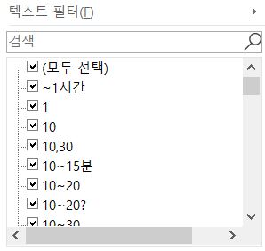
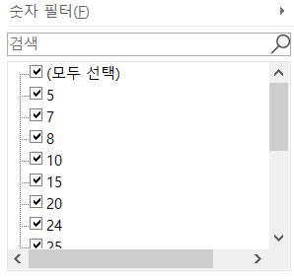
I-Tub Data Preprocessing
Age
Temperature
Bath start time
4
Bathing time
1
2
3
Table4 : Bathing time
Average | MIN | MAX
23 | 5 | 120
4
Bathing time
● Remove all characters to save to an integer field

Slide 21
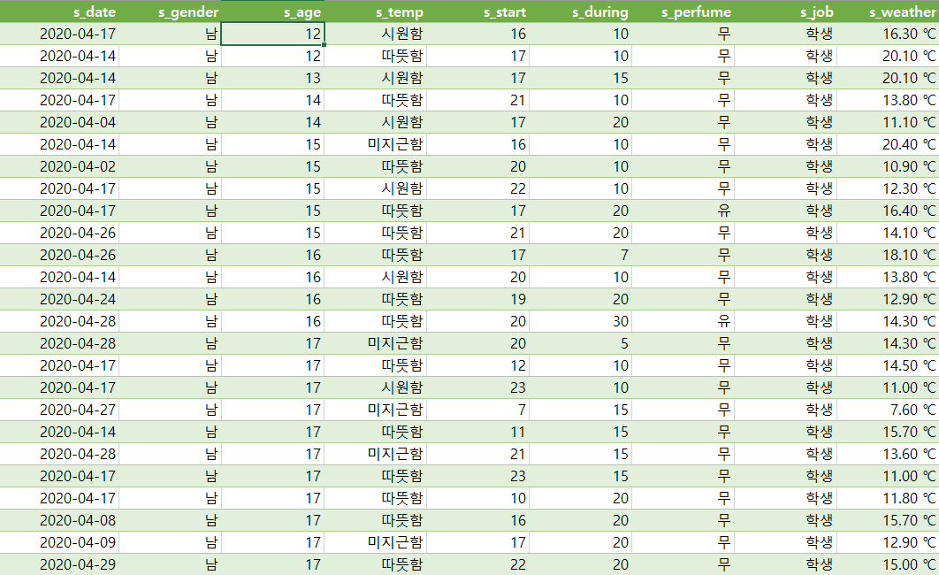
I-Tub Result of Data Preprocessing
s_date | s_gender | s_age | s_temp | s_start | s_during | s_perfume | s_job | s_weather
Basic table columns of survey
name | Description
s_gender | Surveyor`s gender
s_age | Surveyor`s age
s_temp | Surveyor`s temperature
s_start | Surveyor`s start bath time
s_during | Surveyor`s bath time
s_perfume | Surveyor`s bath bomb use status
s_job | Surveyor`s job
Add colums to basic table
name | Description
s_date | Surveyor`s date surveyed
s_weather | Weather of the date surveyed

Slide 22
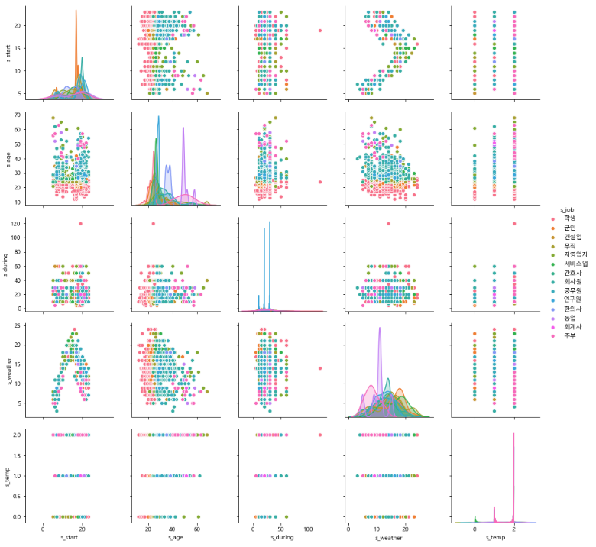
I-Tub Data Visualization (Scatterplot between all elements)
To represent the relationship between two variables using orthogonal coordinates
Based on data of job, we found that bath time and temperature were randomly distributed as
unnecessary factors,
But in the case of bath start time by age was clustered and
necessary for prediction

Slide 23
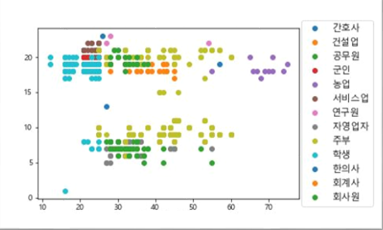
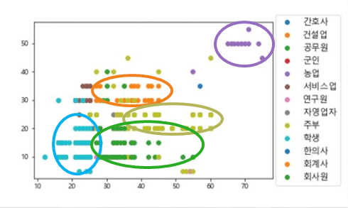
I-Tub Data Visualization (relationship between age and bath during time or bath start time)
Graph of age and bath druing time
Depending on the age,
Can see that bath time or bath start time is clustered
bath during time
Graph of age and bath start time
age
bath start time
Judging that the factors related to the age and bath time are correlated
age

Slide 24
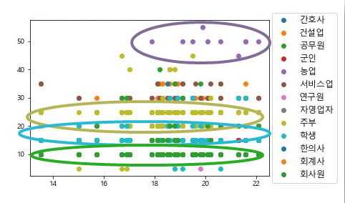
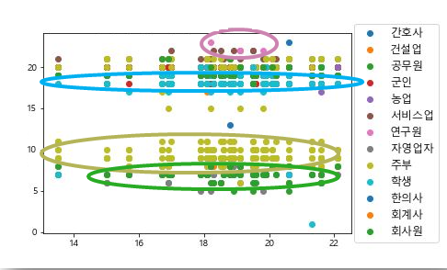
I-Tub Data Visualization(relationship between weather and bath during time or bath start time)
Graph of weather and bath during time
Depending on the weather,
Can see that bath time or bath start time is clustered
bath during time
Graph of weather and bath start time
weather
bath start time
Judging that the factors related to the weather and bath time are correlated
weather

Slide 25
I-Tub Result of Data Analysis
1. The time elements of shower are distinguished by age
2. The time elements of shower are distinguished by job
3. The time elements of shower are distinguished by weather
Knowing age, job and weather can distinguish and
Predict elements related to shower time

Slide 26
I-Tub Data Learning Model
Comparing and Selecting
The best model has higher precision and recall than another models
● Accuracy : A figure of correct answers matched by model`s predictions
● Precision : A figure of how many include of correct answer by model`s predictions
● Recall : A figure of correct answers predicted by model
● F1-score : Harmonic mean of precision and recall
(A figure obtained by Harmoinic mean of precision is overwhelmingly higher than recall or vice versa)

Slide 27
I-Tub Data Learning Model
Comparing and Selecting
● Comparisons show that the XGBoost model has the best figures, but it takes the longer to predict, so we select the faster and the next best model, RandomForest
Model name | Accuracy | Precision | Recall | F1-score
DecisionTree | 65% (train : 76%) | 66% | 65% | 64%
RandomForest | 65% (train : 77%) | 66% | 65% | 64%
XGBoost | 66% (train : 76%) | 66% | 66% | 66%
K-nearest-neighbors | 50% (train : 50%) | 51% | 50% | 49%

Slide 28
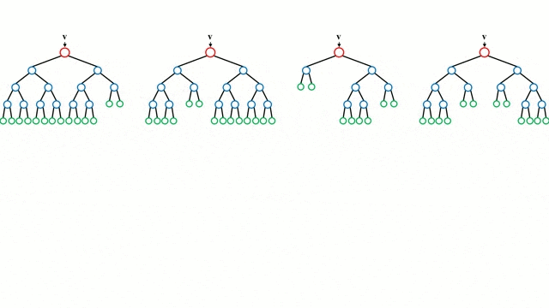
I-Tub Data Learning Model Selection
RandomForest
The method of determining characteristics as ‘yes’ or ‘no’ by the tree is user to estimate the final values and to collect all the predicted trees and select the forecasts on the principle of average or majority rule

Slide 29
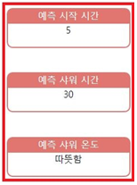
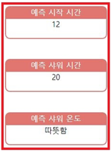
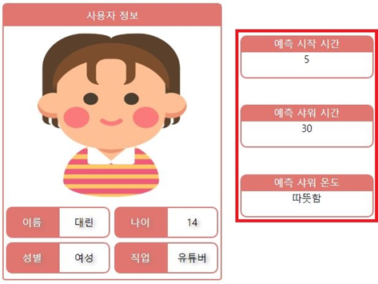
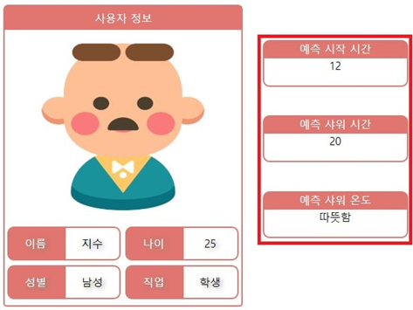
I-Tub Result of Model Prediction
Using information about user`s age, gender, job and day`s weather,
We can predict different predictions
prediction 1 | Prediction 2

Slide 30
I-Tub Service Implement
and Prototype Modeling
I-Tub Website Diagram
I-Tub Website Implementation
I-Tub Prototype Modeling

Slide 31
I-Tub Website Diagram
4
Own setting
Website Configuration
New registration
Select user
Select about three modes
User can setting own favorite options
Recommend options that matched user
Show statistical of age, gender, etc..
Show options that user use and
use additional function
1
2
3
5
7
Register
Select Profile
Select mode
Recommend mode
Using
6
Online mode

Slide 32
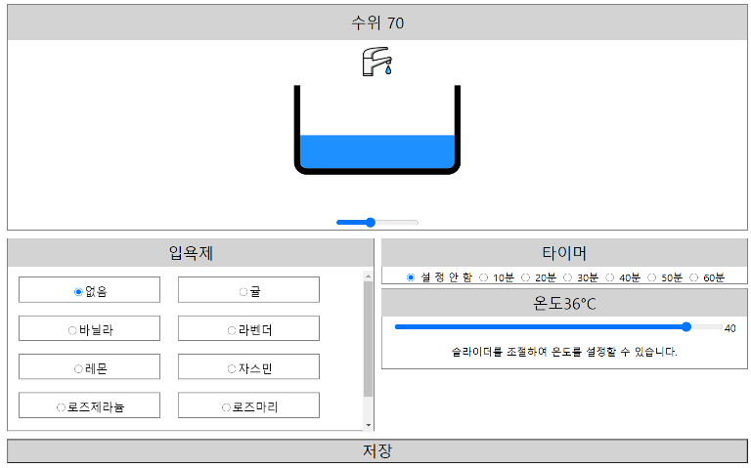
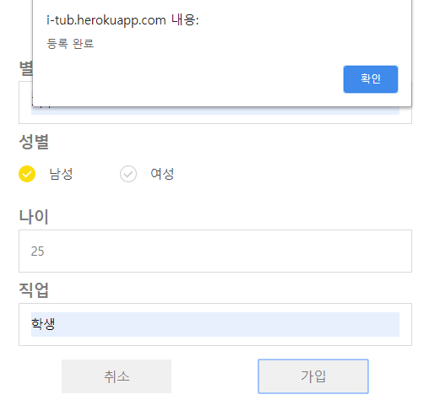
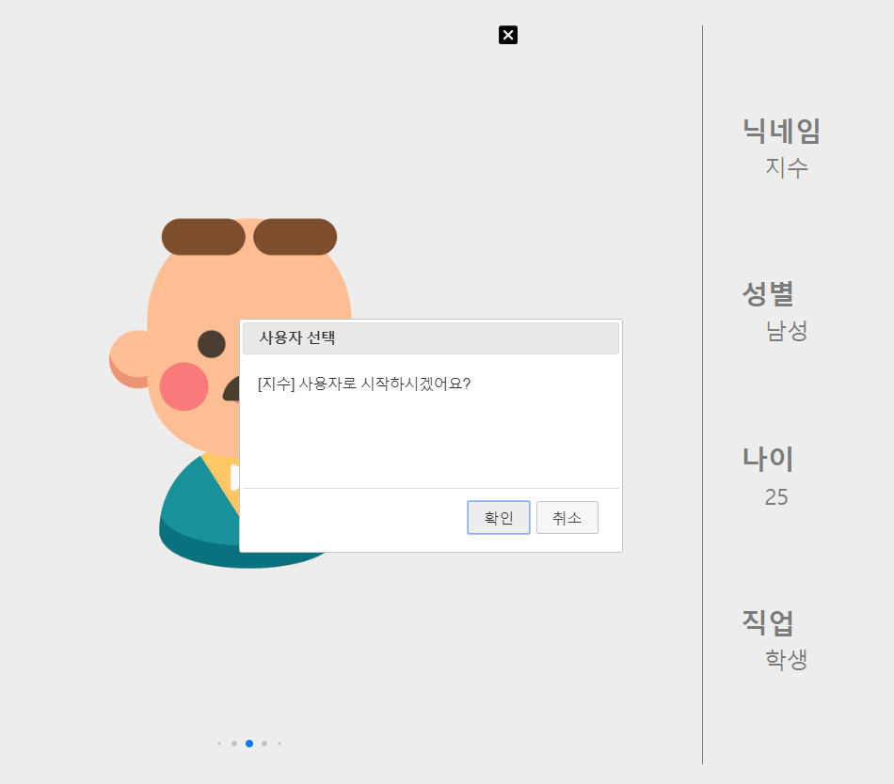
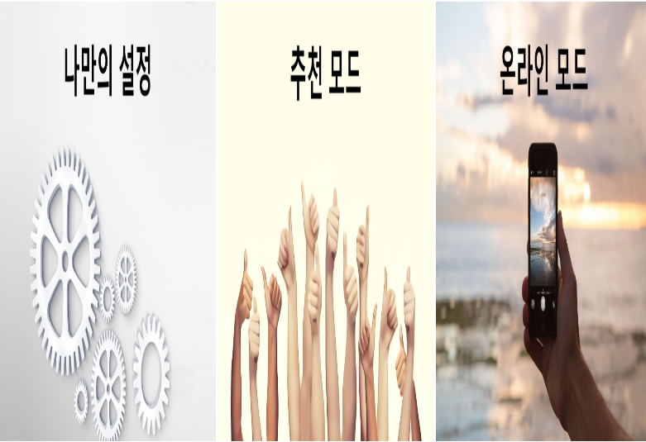
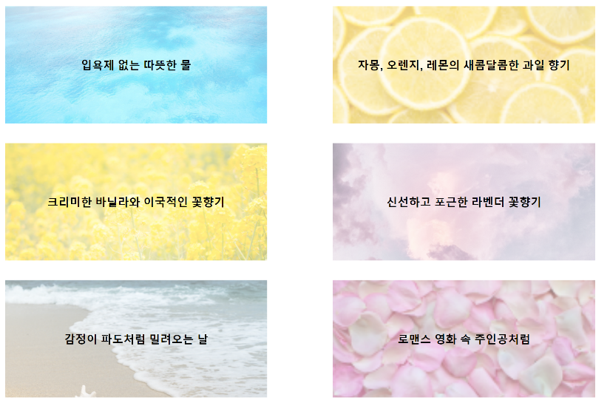
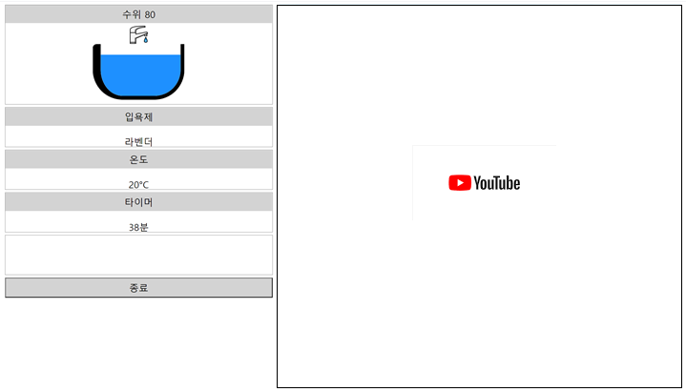
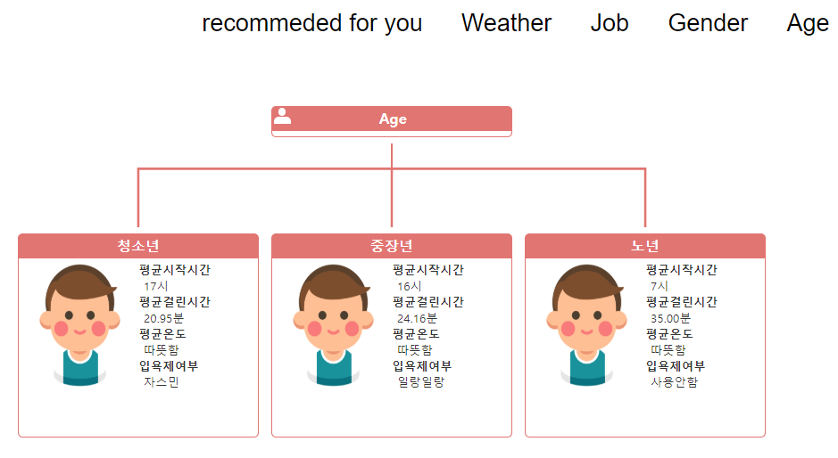
I-Tub Website Diagram
Own setting mode
Register
User select
Mode select
Recommend mode
Using
Online mode

Slide 33
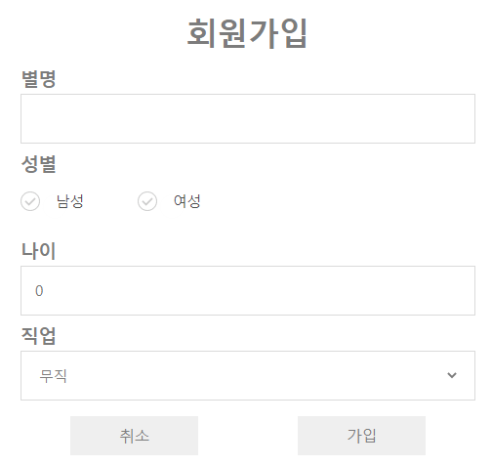
I-Tub Website Implementation (register page)
Register
1
Member registration screen
For new user registration
● Information for registration
1. Name(Nick Name)
2. Gender
3. Age
4. Job
(When write user information and register, to send data at server)

Slide 34
I-Tub Website Implementation (user select page)
User select
2
Select users page where
You can select registered users
(Show user`s information on the right )
(When the user click, page is asking whether to select it through the dialogue window.)
(When you choice user, brings up user data stored on the server)

Slide 35
I-Tub Website Implementation (mode select page)
Mode select
Mode select page that Have three modes
3
(Press mode to go to that page)

Slide 36

Mode select
3
I-Tub
Website Implementation (custom setting page)
Own setting
Recommend mode
Online mode
4
5
6
Own setting
4
My own setting page where
You can select and save the options you want
● Option list
1. water level [0~100 height]
2. select bathbomb [by perfume]
3. select timer [0 ~ 60 minute]
4. temperature level [0 ~ 40℃]
(When select options that you want and submit, data stored to server)

Slide 37
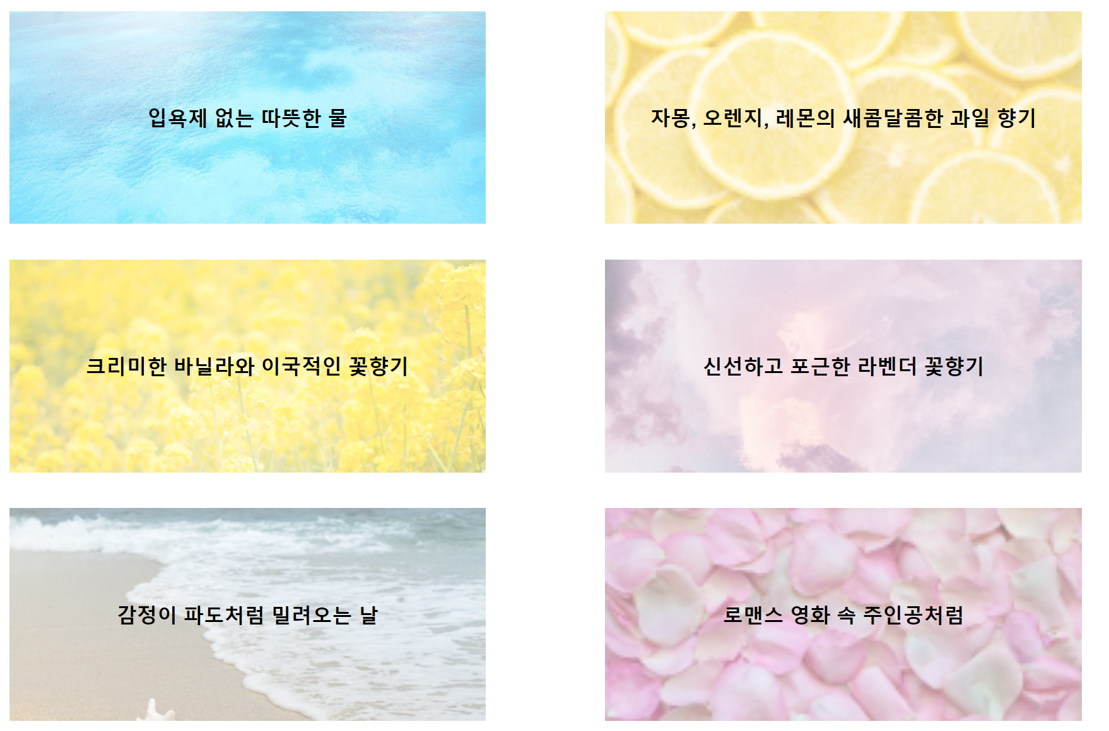
Mode select
3
I-Tub
Website Implementation (user recommend page)
Own setting
Recommend mode
Online mode
4
5
6
Recommend mode
5
A page that is
Simple to use for pre-created themes
(When select one in various modes , be started)

Slide 38
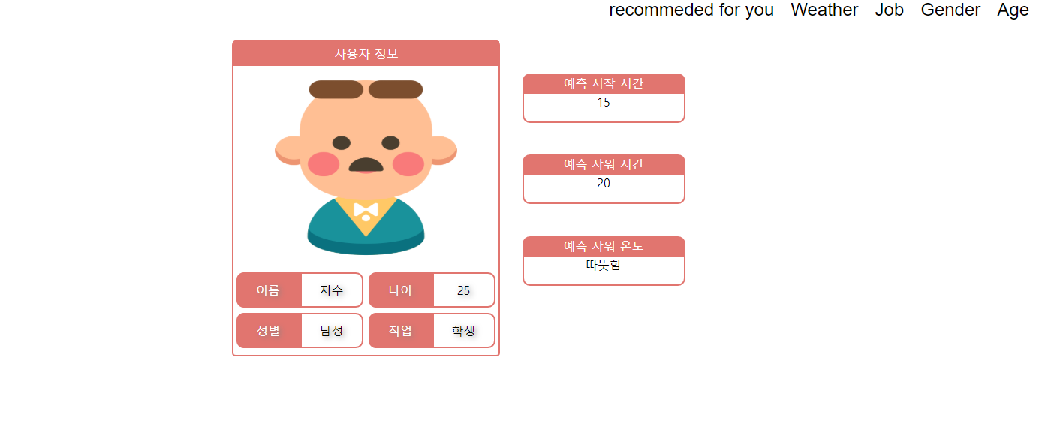
Mode select
3
I-Tub
Website Implementation (online mode page)
Own setting
Recommend mode
Online mode
4
5
6
Online mode
6
Show bath data which are
Statistics by gender, age, job, and weather
Show that recommended values predicted by models learned by machine learning
● [Statistic list]
gender : male, female
age : 10s~70s
job : student, housewife, etc..
(Total : Thirteen)
weather: 5 ~ 40℃
(Reads data stored on the server and shows it in charts by categories)

Slide 39
I-Tub Website Implementation (user using page)
Using
Check options that oneself select
[water level, bath bombs,
temperature, timer]
Showing you a something like
video site to enjoy when you take a bath
7
(Show options that user using now, provide media on the right)

Slide 40
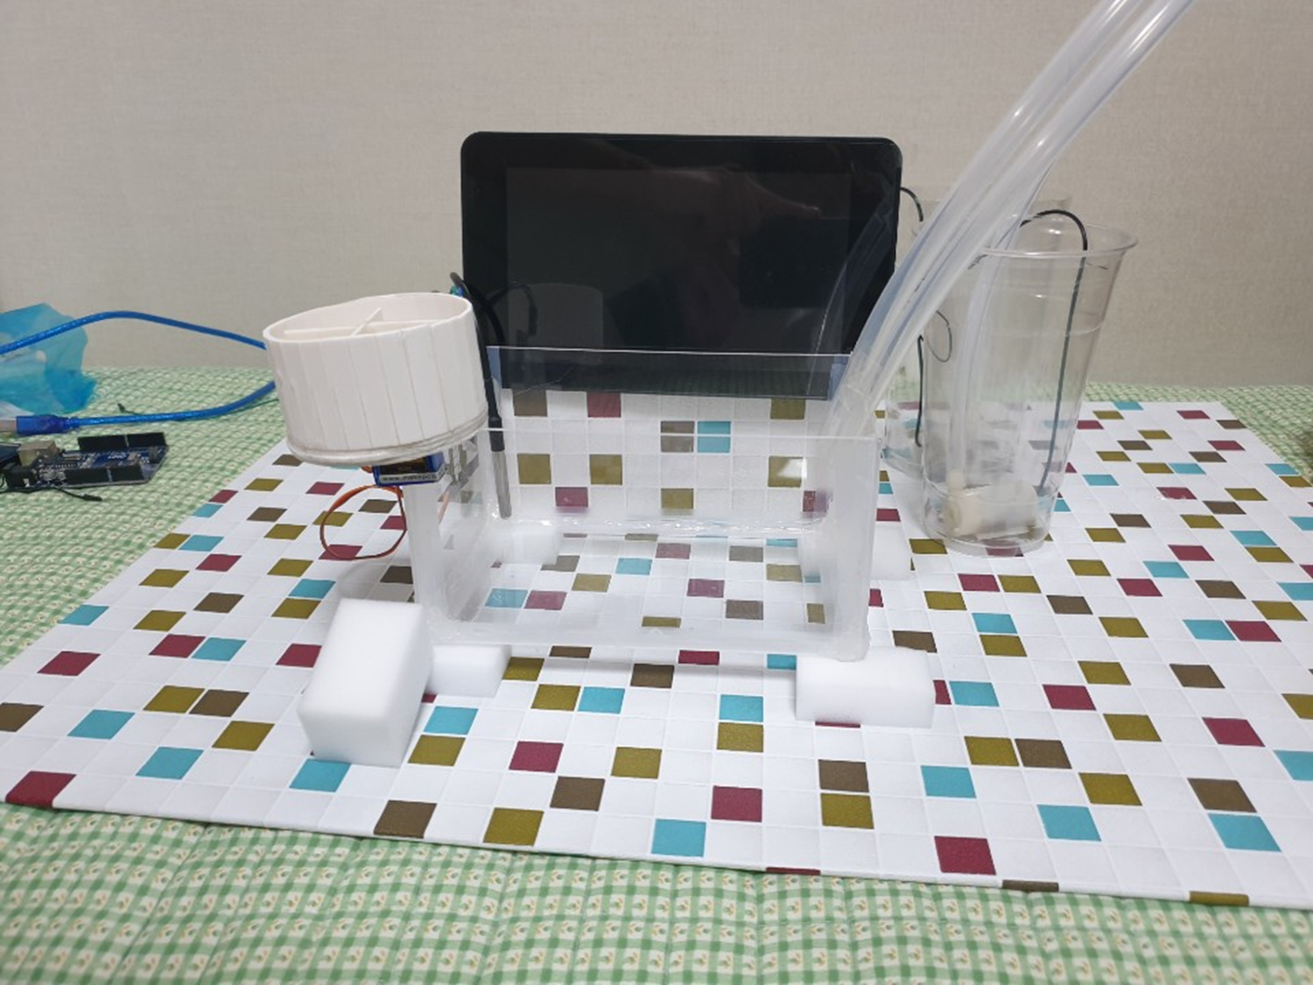
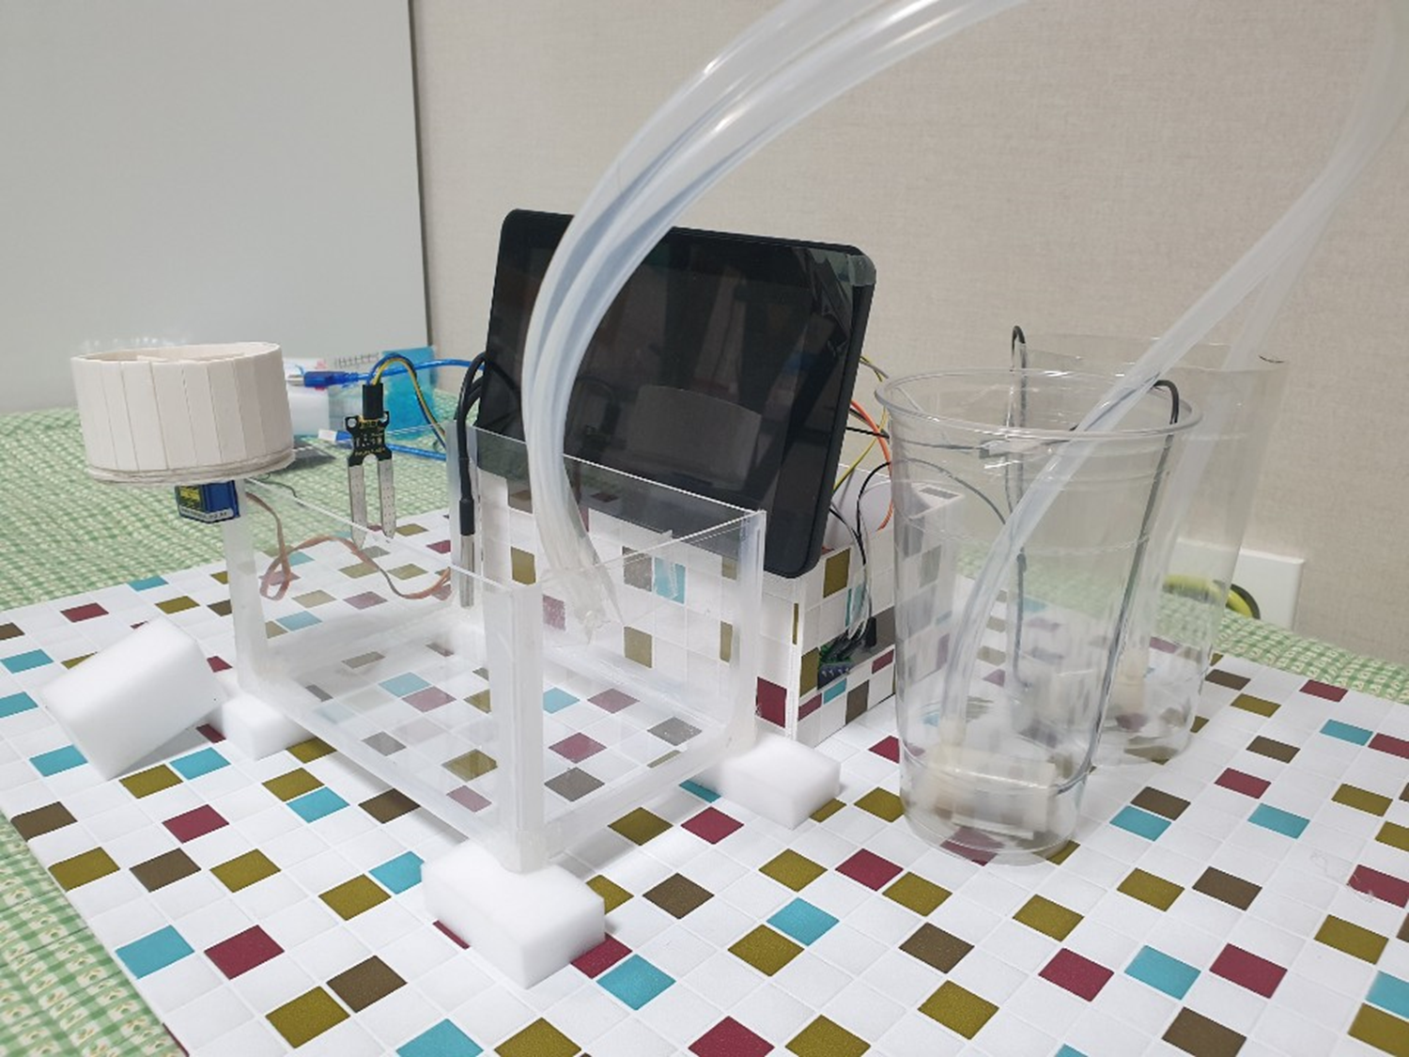
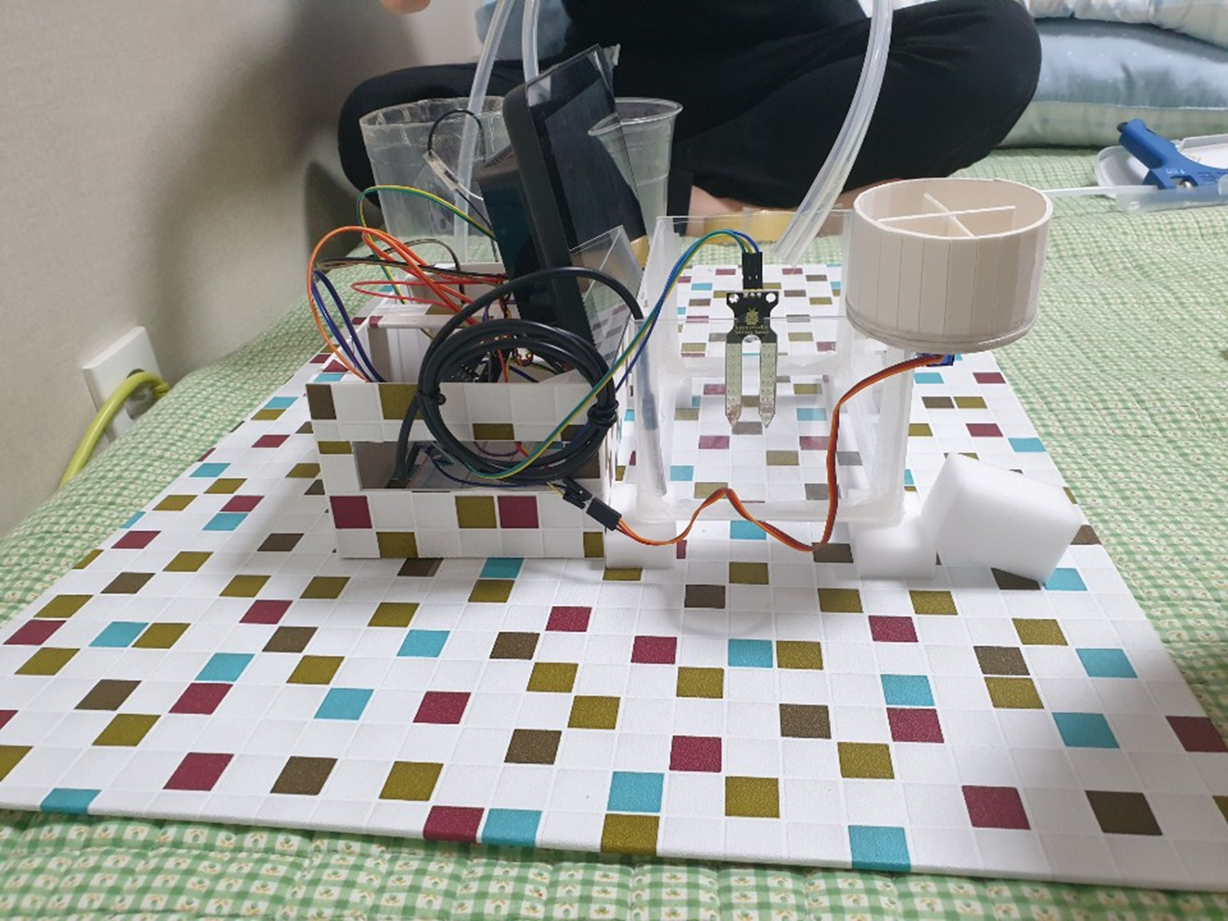
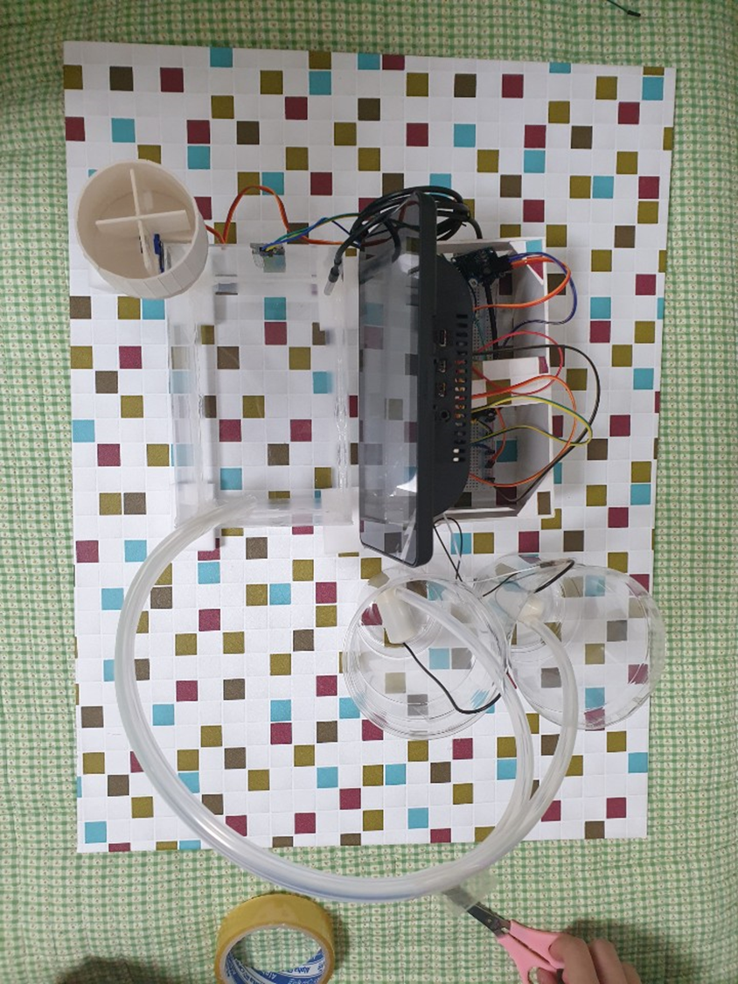
I-Tub Prototype Modeling
Parts of Prototype
- Water pump
- Water level and temperature
sensor, servo motor
- Raspberry Pi and monitor

Slide 41
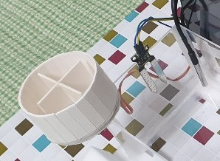
I-Tub Prototype Modeling
Waterlevel sensor, temperature sensor,
Measure the water level and temperature of the bathtub
Servo motor
Input bathbombs into the bathtub

Slide 42
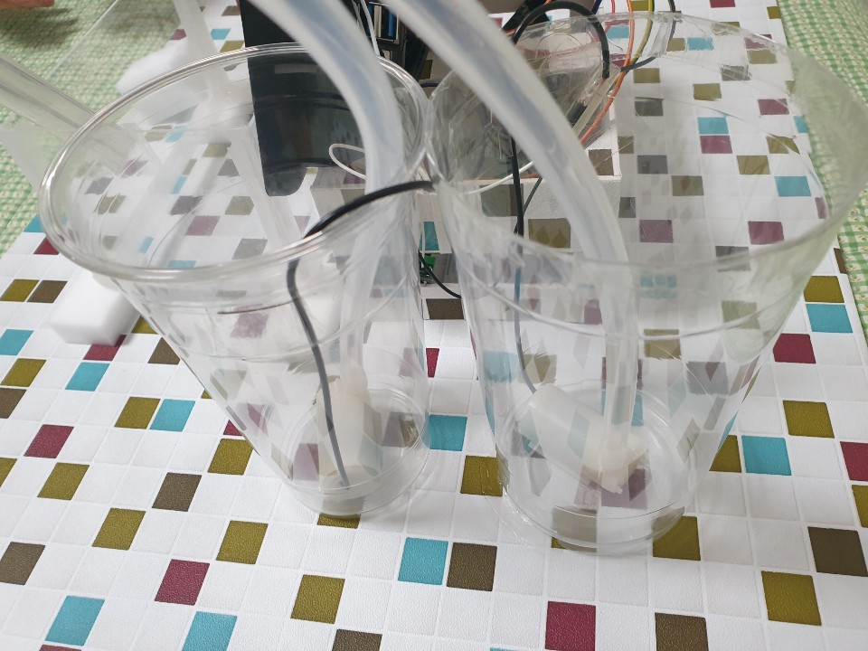
I-Tub Prototype Modeling
Pumping the water
by using water pump
To supply water to the bathtub, adjusting to the set temperature and water level
Hot water, Cold water

Slide 43
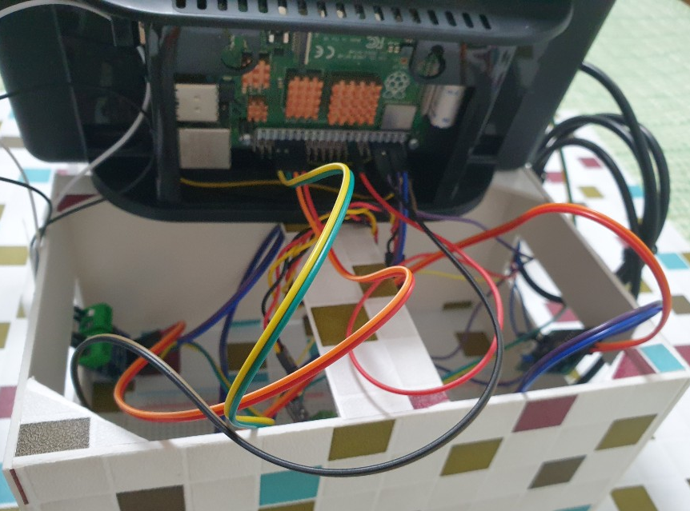
I-Tub Prototype Modeling
Provide Web service for user and
Control various sensor

Slide 44
I-Tub Service Result
I-Tub service Demo (Video)

Slide 45
I-Tub Supplement Points
Data did not exist, it was collected directly. So the data lacks validity
Expect to be able to solve the problem through professional surveyors or through cooperation with bathtub operators
Hot water cannot be used due to functional problems of sensors
Solve the problem by investigating and replacing
with a suitable part

Slide 46
References
https://opentutorials.org/course/1 (to using javascript)
https://opentutorials.org/course/3780/18031 (html and css guide)
https://github.com/dabeng/OrgChart (orgchart open source of to show statistical on online mode)
https://dabeng.github.io/OrgChart/ (orgchart example)
https://win.adrirobot.it/sensori/moisture_sensor/moisture_sensor.html(soil mosture sensor example)
https://blog.naver.com/elepartsblog/221726825667 (rasbian install to use raspberry pi)
https://www.raspberrypi.org/ (rasbian install reference library to use raspberry pi)
https://www.circuitbasics.com/raspberry-pi-ds18b20-temperature-sensor-tutorial/ (temperature sensor example)
https://blog.naver.com/rhrkdfus/221373635978 (rasbian wireless mouse solving an obstacle)
https://www.kocoafab.cc/fboard/view/1089 (understanding the principles of mini-breadboard)
https://www.inflearn.com/course/node-js-%EC%9B%B9%EA%B0%9C%EB%B0%9C# (understanding node.js for webserver to handle user requests)
https://swiperjs.com/api/ (swiper API to use profile select page)

Slide 47
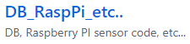






Lim Daein | Park Jisu | Jeong Haemin | Seo Jeonguk
Github Introduce
https://github.com/Ultimate-ItubProject
Repository that storage of databases, raspberrypi codes, and ambiguous files to categorize
Repository that Storage of I-Tub Webpage code consists of HTML, JS, PY codes
Repository that Storage of Weekly, Middle, Final reports

Slide 48
Question?

Slide 49
Thanks.

